Slide 1
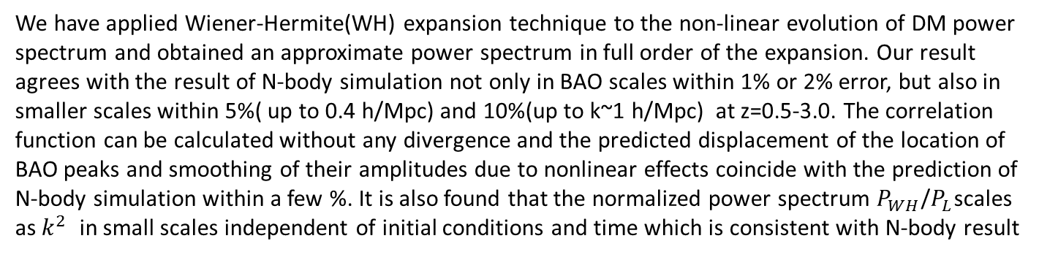
WH expansion applied for Non-linear Evolution of matter Perturbation
T. Futamase
Astronomical Institute, Tohoku University, JAPAN
Abstract
We have applied Wiener-Hermite(WH) expansion technique to the non-linear evolution of DM power spectrum and obtained an approximate power spectrum in full order of the expansion. Our result agrees with the result of N-body simulation not only in BAO scales within 1% or 2% error, but also in smaller scales within 5%( up to 0.4 h/Mpc) and 10%(up to k~1 h/Mpc) at z=0.5-3.0. The correlation function can be calculated without any divergence and the predicted displacement of the location of BAO peaks and smoothing of their amplitudes due to nonlinear effects coincide with the prediction of N-body simulation within a few %. It is also found that the normalized power spectrum $P_{WH}$/$P_{L}$scales as $k^{2}$ in small scales independent of initial conditions and time which is consistent with N-body result

Slide 2





1. WH expansion approach to evolution of density fluctuation
We apply the WH expansion to solve Navier-Stokes equation in cosmological situation without rotational mode.
where 、 , are the density contrast, velocity divergence, respectively, α and β describes non-linearity of gravitational interaction
Then the density contrast may be expanded in the following way(similarly for θ）
where are an orthonormal bases in the space of random function with the following properties
The equations for the coefficients of each order are obtained from the basic equations above by multiplying a corresponding base and then take the ensemble average

Slide 3


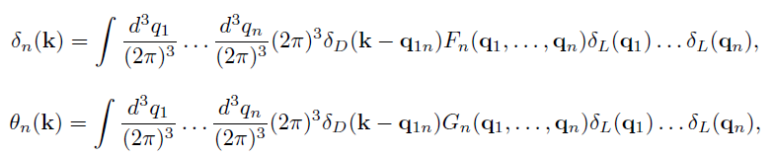

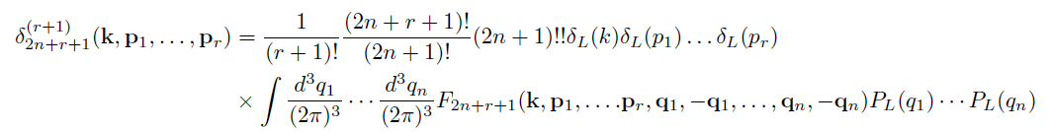
2. Relation to SPT and high-k limit
The WH expansion is related with the Standard Perturbation Theory(SPT) in the following way.
SPT can be formally solved in Einstein-de Sitter universe as a power series of scale factor as follows
with and
where and F, G obey some recursion formula
Comparing WH expansion we find
with

Slide 4



Since we are interested in non-linear evolution which becomes important in small scales, we consider the density contrast in high-k limit. Then we can use the result to have an approximation for the power spectrum valid from small scale(non-linear region) to large scale(linear region)
First one can prove the following relation by induction on n
where
Using this limit one can show
Thus we have
The total power spectrum thus have the following high-k limit

Slide 5

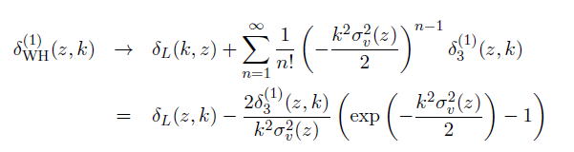
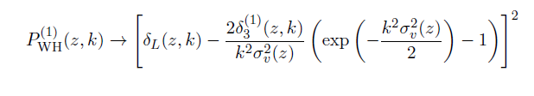
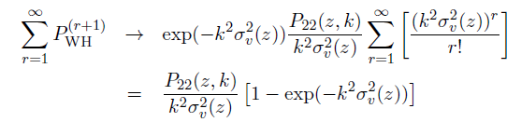
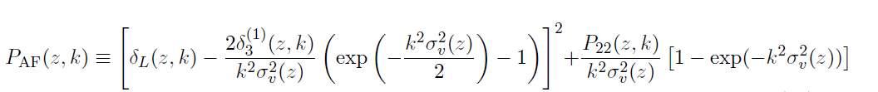
3. An approximation for the total power spectrum
We further approximate the above expression and make a manageable form.
First we consider the first order of WH expansion (r=0). Using similar limit as above
This gives
Then the contribution to the power spectrum is as follows
For higher order contribution we can show
Combining these two contribution we have our result

Slide 6
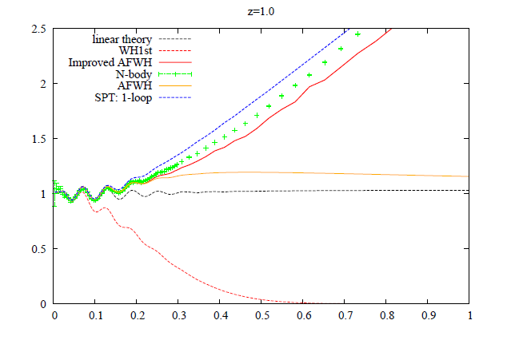
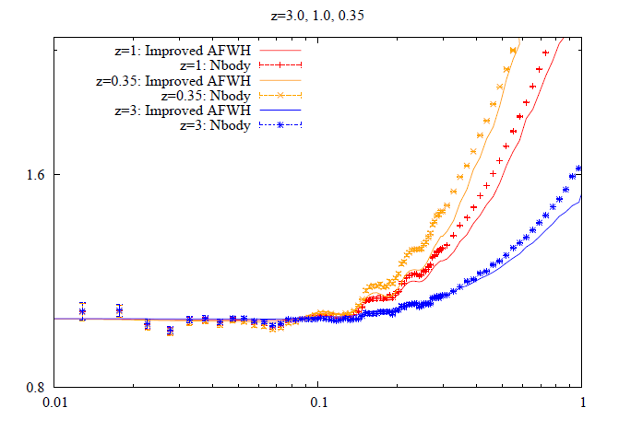

4. Results
Our result
Acknowledgment
This work is a result of the collaboration with Naonori Sugiyama and Yuki Mochizuki. We would like to thank A. Taruya, T. Nishimichi for providing us the results of numerical simulation and useful comments. This work is supported in part by GCOE program” Weaving Science Web beyond Particle-matter Hierarchy” at Tohoku University and by a Grant-in –Aid for Science Research from JSPS
References
M. H. Goroff, et.al. ApJ311, (1986)
F. Bernardeau et.al. Phys. Rept.367, (2002)
F. Bernardeau, M. Crocce and R. Scoccimaro, PRD78, (2008)
Taruya, et.al. PRD80, (2009)
T. Futamase MNRAS192, (1980)

