Slide 1
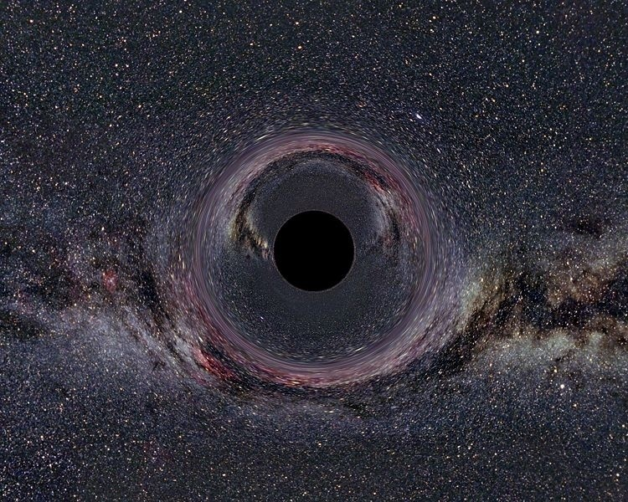

On integrability of spinning particle motion in higher-dimensional rotating black hole spacetimes
David Kubizňák
(Perimeter Institute)
Relativity and Gravitation
100 Years after Einstein in Prague
Prague, Czech Republic
June 25 – June 29, 2012

Slide 2
Plan of the talk
Spinning particle in curved rotating BH background
Semiclassical theory of spinning particle
    Hamiltonian formulation
    Non-generic superinvariants: “SUSY in the sky”
    On integrability in all dimensions
Conclusions
Based on:
DK, M. Cariglia, Phys. Rev. Lett. 108, 051104 (2012); arXiv:1110.0495.
M. Cariglia, P. Krtous, DK, in preparation.

Slide 3
I) Spinning particle in curved rotating BH background

Slide 4
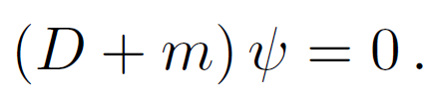

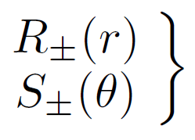

Spinning particle in curved rotating BH background
a) Quantum description: Dirac equation
Separable!
“Enough integrals of motion 2 symmetry operators”
obey decoupled 2nd-order ODEs
complete set of mutually commuting operators
See Marco’s talk!

Slide 5

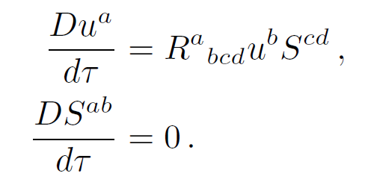
Spinning particle in curved rotating BH background
b) Classical GR description: Papapetrou’s Eq.
gauge fixing (not unique)
Chaotic motion!
(even in Schwarzchild due to spin-orb. int.)

Slide 6

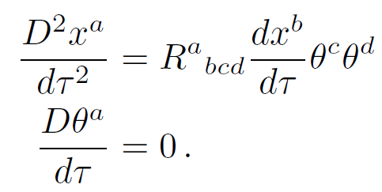

Spinning particle in curved rotating BH background
c) SUSY semi-classical spinning particle
Integrable?
“Classical Hamiltonian system”
“bosonic”
“fermionic”

Slide 7

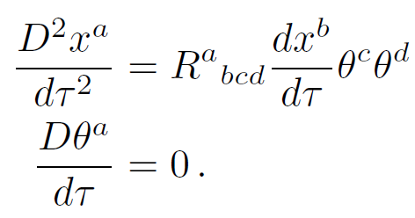
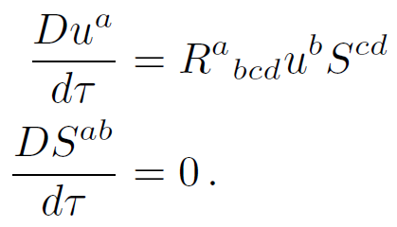


Spinning particle in curved rotating BH background
Quantum
SUSY: spinning
Classical
Separable!
complete set of comm.ops
Integrable?!
Chaotic!
No spin (nontriv)
Klein-Gordon Eq.
WKB
Geodesic Eq.
Separable!
Carter: Completely integrable!

Slide 8
II) Semiclassical theory of spinning particle

Slide 9
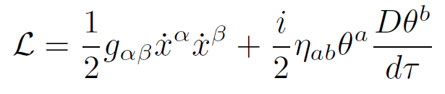
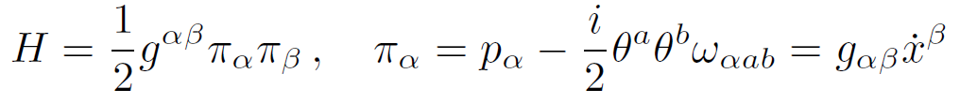
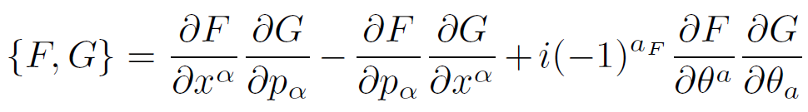



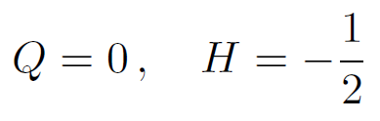
A little more about spinning particle
Hamiltonian formulation:
covariant
Poisson bracket
SUSY
Physical (gauge) conditions
canonical

Slide 10


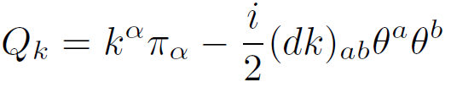

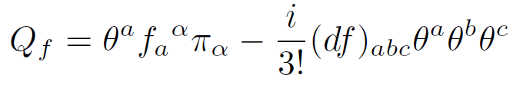


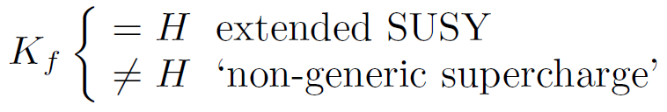
Nongeneric superinvariants: SUSY in the sky
Gibbons, Rietdijk, van Holten, Nucl. Phys. B404 (1993) 42; hep-th/9303112.
Automatically an integral of motion
Linear in momenta superinvariants
Killing-Yano 2-form

Slide 11



SUSY in the sky: Kerr geometry
Set of commuting operators:
“bosonic”
“fermionic”
(no classical analogue)
Bosonic set of commuting operators :
terms
SUSY in the sky
can take a limit and recover Carter’s result
Problem: “integrates” only bosonic equations. What about fermionic?

Slide 12
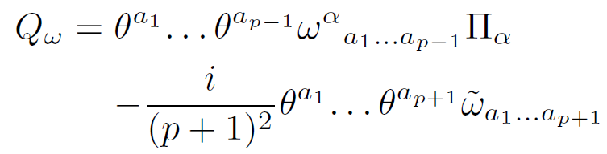

SUSY in “astral spheres”? Kerr-NUT-AdS geometry
Linear superinvariants
Although there is a whole tower of these (Valeri’s talk),
they do not commute!
However, in all D dimensions one can construct D bosonic integrals of mutually commuting integrals of motion
making the bosonic part of the motion integrable.

Slide 13








Conclusions
We have shown the existence of D mutually commuting bosonic integrals of spinning motion in Kerr-NUT-AdS black hole spacetimes in all dimensions D. This generalizes the previous result on complete integrability of geodesic motion. Non-spinning limit can be easily taken.
Integrability of “fermionic sector” remains unclear at the moment.
There are interesting connections to “quantum” and “classical” descriptions:
  Dirac limit:
  Papapetrou’s limit:
Grassmann algebra s Clifford algebra
operator ordering
(satisfies Lorentz algebra)
(Integrals OK to linear order)

