Slide 1
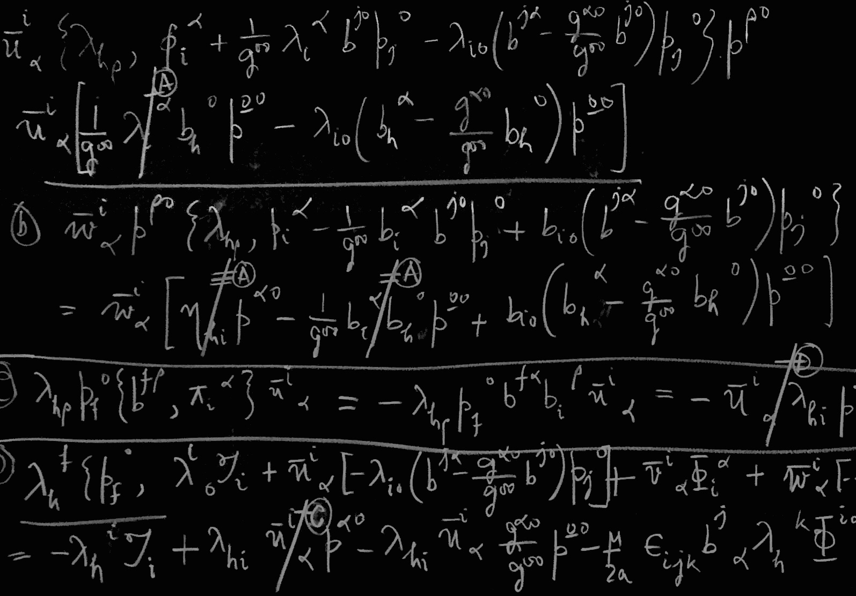
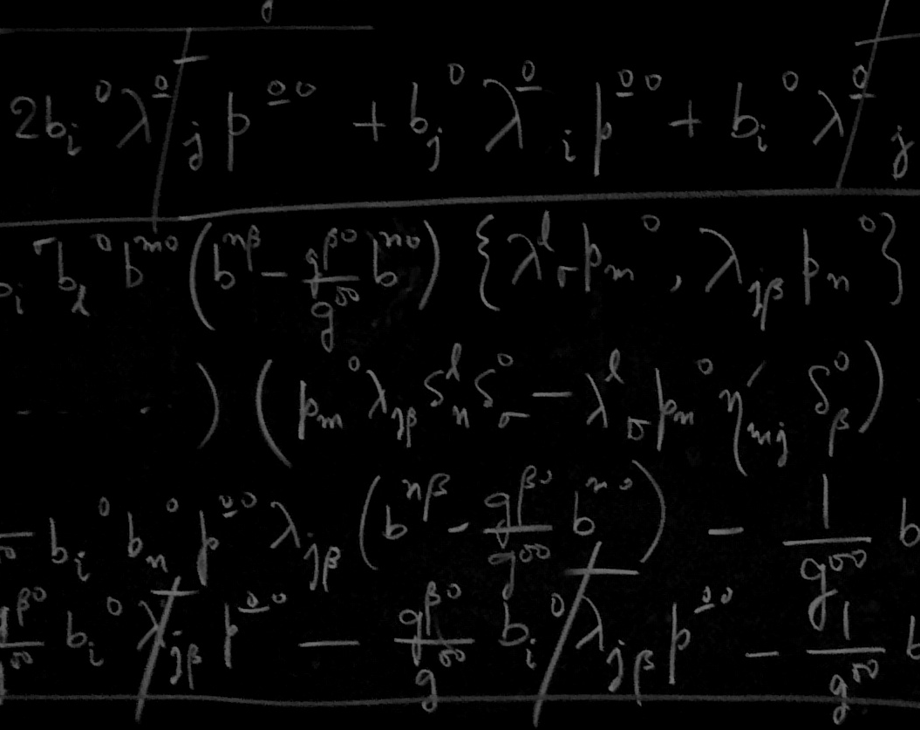

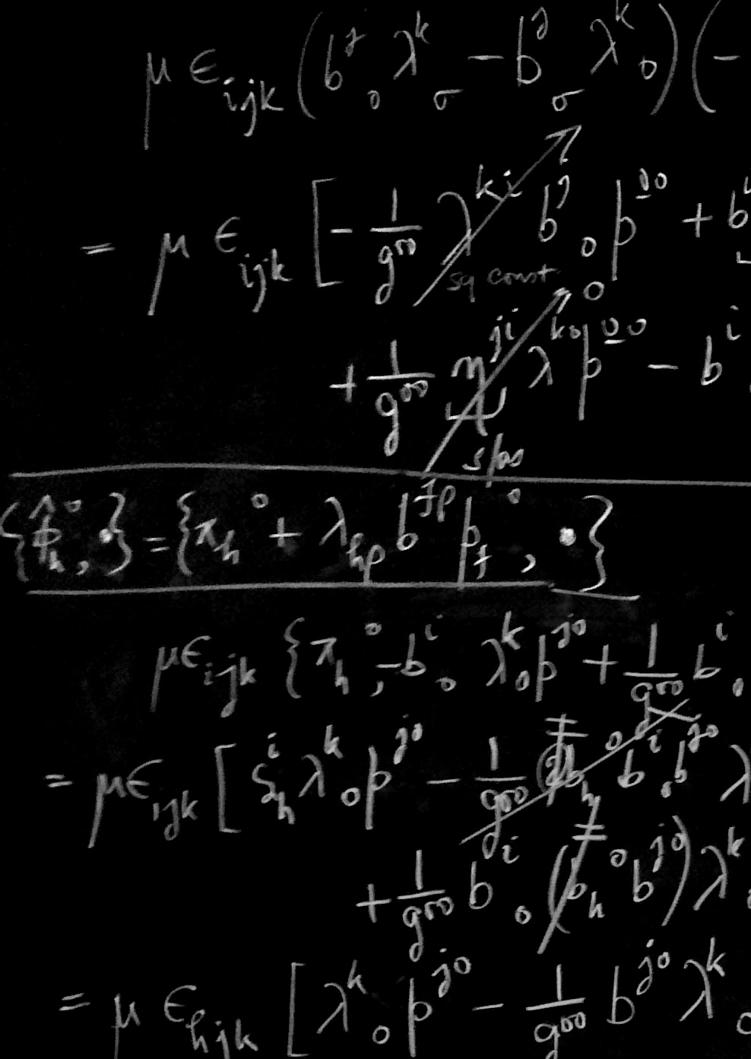
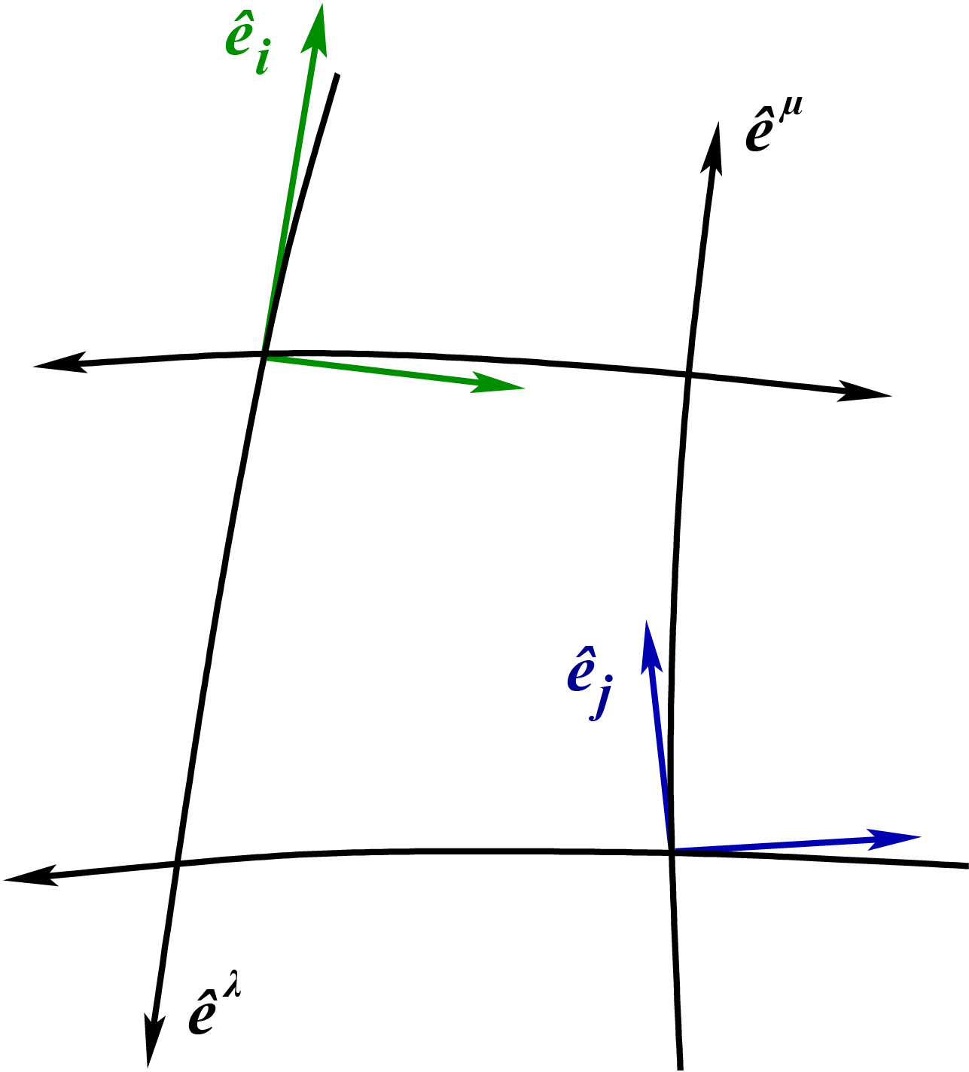
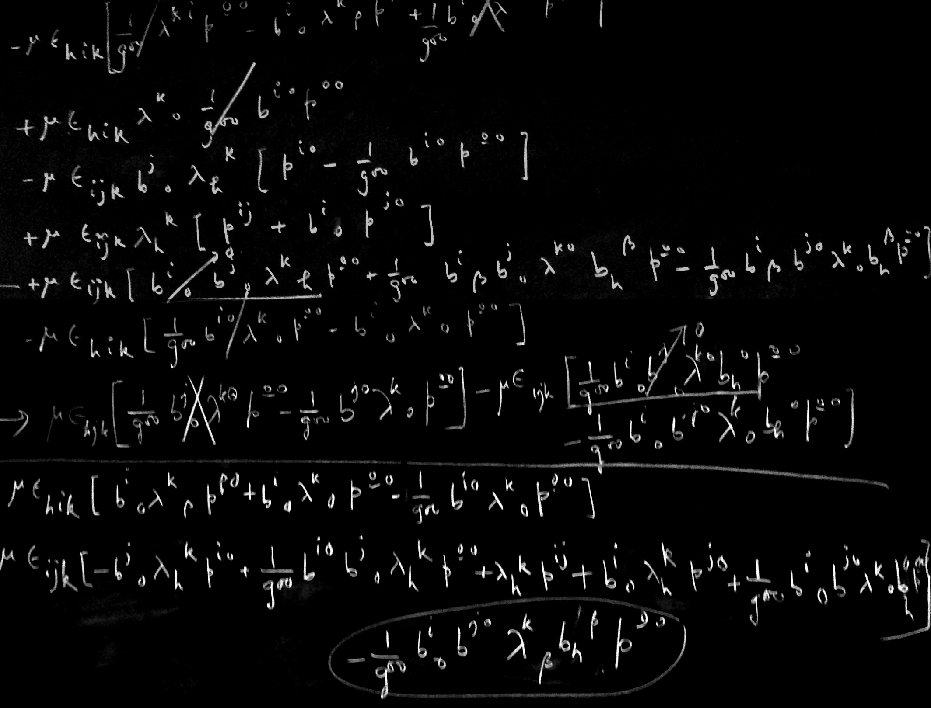
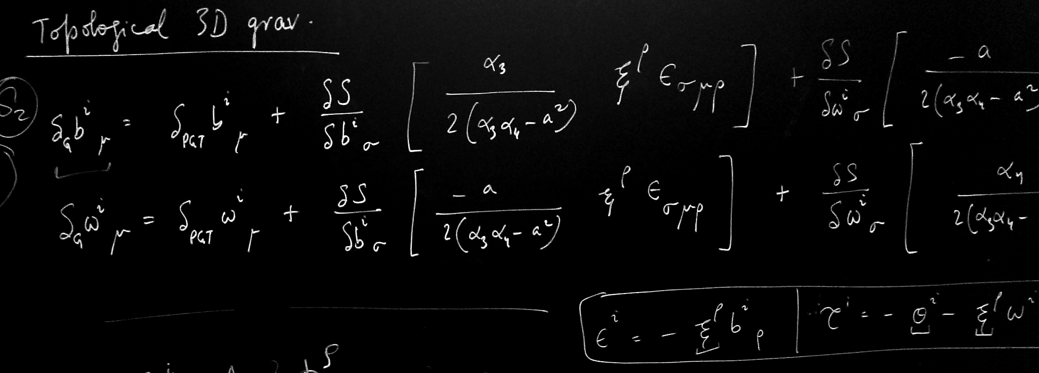





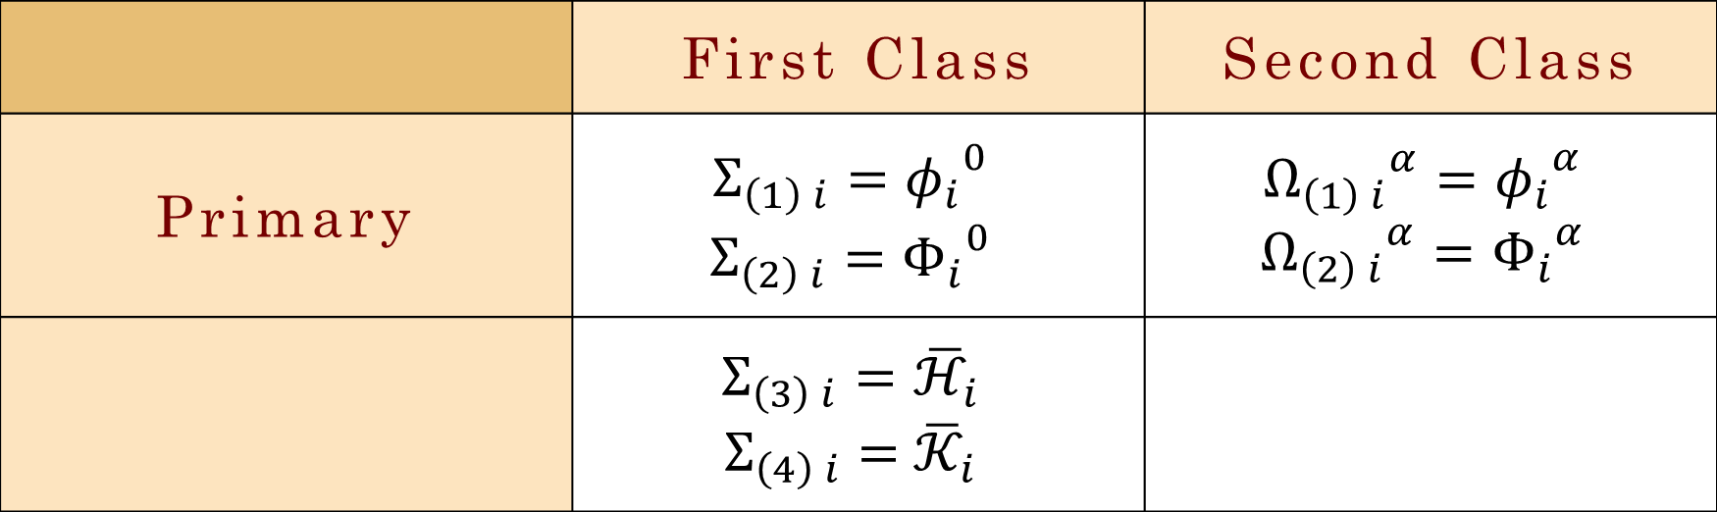
*S. N. Bose National Centre
for Basic Sciences,
Kolkata, India.
Trivial symmetries in
models of gravity
Rabin Banerjee*, ¹, Debraj Roy^{*, 2}
¹rabin@bose.res.in, ²debraj@bose.res.in
Overview of the problem
Recover Poincare symmetries in models of gravity
via a canonical hamiltonian method.
Find appropriate canonical gauge generators.
Canonical methods apparently do not generate Poincare symmetries.
Two independent off-shell symmetries of the same action !
We show: they are canonically equivalent, modulo a trivial symmetry.
Hamiltonian Constraints
 | First Class | Second Class
Primary | $$Σ_{\left(1\right) i}={φ_{i}}^{0}$$ $$Σ_{\left(2\right) i}={Φ_{i}}^{0}$$ | $${Ω_{\left(1\right) i}}^{α}={φ_{i}}^{α}$$ $${Ω_{\left(2\right) i}}^{α}={Φ_{i}}^{α}$$
 | $$Σ_{\left(3\right) i}={\overline{ℋ}}_{i}$$ $$Σ_{\left(4\right) i}={ \overline{𝒦}}_{i}$$
The Poincare gauge construction
Gauge theory of the Poincare group: Poincare Gauge Theory (PGT)
[Utiyama, Kibble, Sciama].
Let’s start on a 3D space spanned by
basis vectors ${\hat{e}}^{μ}$ (black lines)
Introduce local frames as tangent spaces at
each point, spanned by ${\hat{e}}^{i}$ (coloured lines)
Global Poincare transformations
Lagrangian $ℒ\left(φ,∂φ\right)$ invariant under this
On localization, $\text{θ} \text{and} ε$
become functions of global coords $x^{μ}$
To maintain invariance of $ℒ$, additional fields & covariant derivative
$b \text{and} ω$are the vielbeins and spin-connections
Field strengths → gravity: the Riemann and Torsion fields
The new Lagrangian $\overline{ℒ}\left(φ,∇φ\right)$ is then found to be invariant under the following PGT symmetries of the basic fields $b \text{and} ω$
Hamiltonian generator & symmetries
Define structure functions ${{ C}^{K}}_{IJ}$ and ${V^{J}}_{I}$
$\left\{Σ_{I} ,Σ_{J}\right\}={C^{K}}_{IJ} Σ_{K}$ ; $\left\{H_{C} , Σ_{I}\right\}={V^{J}}_{I} Σ_{J}$
Gauge generator → sum of 1st class constraints → $G=\int{ε^{I} Σ_{I}}$
where $ε^{I}$ are gauge parameters. Not all of these $ε^{I}$are independent
Demanding commutation of arbitrary gauge variation with total time derivative: $\frac{d}{dt}\left(δq\right)=δ\left(\frac{d}{dt}q\right)$, where $δq=\left\{q,G\right\}$ and $\frac{dq}{dt}=\left\{q,H_{T}\right\}$
Using these to eliminate dependent gauge parameters from the set $ε^{I}$,
$G={\dot{ε}}^{i} {π_{i}}^{0}+ε^{i} \left[{\overline{ℋ}}_{i}−ε_{ijk}\left({ω^{j}}_{0}−p{b^{j}}_{0}\right)π^{k0}+q ε_{ijk} {b^{j}}_{0} Π^{k0}\right]+$
${\dot{τ}}^{i} {Π_{i}}^{0}+τ^{i} \left[{\overline{𝒦}}_{i}−ε_{ijk}\left({b^{j}}_{0}{ π}^{k0}+{ω^{j}}_{0}{ Π}^{k0}\right)\right]$
The hamiltonian gauge symmetries turn out to be:
A tale of trivial symmetries
To compare the two symmetries → map between gauge parameters
The two symmetries can then be compared
Explicitly, the balance symmetry $δ≡δ_{H}−δ_{P}$ reads:
where,
Here the coefficients Λ are all antisymmetric in the field indices
So the action remains invariant without imposition of eq^{n}s of motion
This is NOT a true gauge symmetry and is NOT generated by 1st class constraints ⇒ $δ_{P}≡δ_{H}$
Riemann-Cartan manifold
Mielke-Baekler type model with torsion
Equations of Motion:
Conventions:
Latin indices: i, j, k, … = 0, 1, 2 : Local frame indices (an-holonomic)
Beginning Greek indices: $α, β, γ$, … = 1, 2 : Global indices (holonomic)
Middle Greek indices: $μ, ν, ρ$, … = 0, 1, 2 : Global indices (holonomic)
Einstein-Cartan
Cosmological term
Chern-Simons
Torsion
References:
R. Banerjee, H.J. Rothe, K.D. Rothe Phys.Lett. B479 , 429 (2000) and ibid. Phys.Lett. B463, 248(1999)
R. Banerjee D. Roy Phys.Rev. D84, 124034 (2011)
R. Banerjee, S.Gangopadhyay, P. Mukherjee, D.Roy : JHEP 1002:075 (2010 )

