Slide 1
Prague waveforms
Vojtěch Witzany
Institute of Theoretical Physics, Charles University, Prague
CzechLISA meeting
11.3. 2024

Slide 2
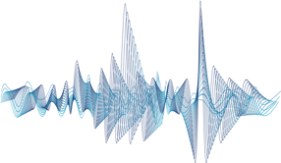
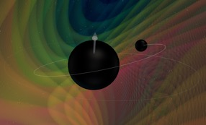
Structure of this talk
Why waveforms and what do we want from them?
Birds-eye view of (LISA) waveform modelling
People at ITP and AsÚ working on dynamics, perturbations, and waveforms
Research highlights and broader collaborations

Slide 3
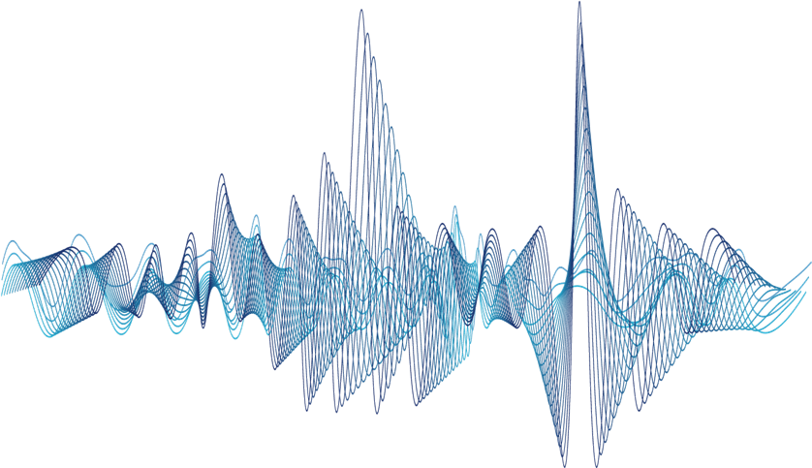
Why waveforms and what do we want from them?
A story of signal and noise, and the optimal match

Slide 4
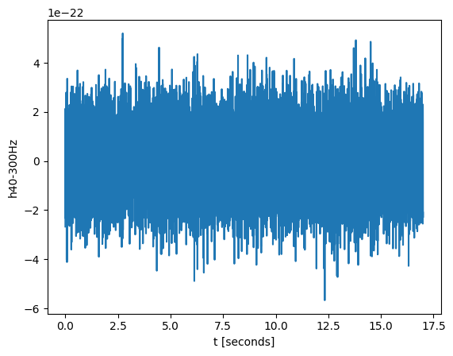
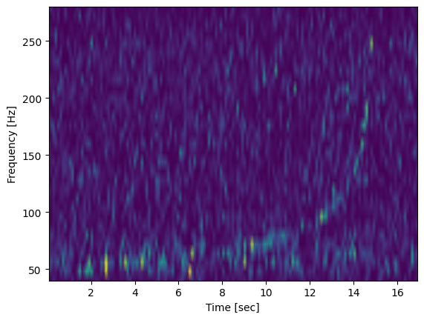
Signals are weak, noise is strong
Bandpassed LIGO Livingston strain in time domain and spectrogram (40-300Hz) for GW170817, The binary neutron star merger.
“Signal to noise ratio” quoted as 32.4 – How is this possible?

Slide 5
The matched filtering method
Imagine a time-series $h\left(t\right)=s\left(t\right)+n(t)$, we want to filter the datastream by projecting the time-series into a filter $F\left(t\right)→∫F\left(t\right)h\left(t\right)dt$.
The SNR corresponding to that filter is
$$SNR_{F}^{2}=\frac{(∫F\left(t\right)s\left(t\right)d{t)}^{2}}{⟨∫(F\left(t\right)n{\left(t\right))}^{2}dt⟩}$$
What is a good or even optimal choice of filter?
In frequency space it is the signal $s$ itself, weighed by the power spectral density of the noise $S_{n}(f)$: ${\hat{F}}_{s}(f)=\hat{s}(f)/S_{n}(f)$
This leads to optimal SNR:
$${SNR}_{match}^{2}=4∫\frac{{\left|\hat{s}\left(f\right)\right|}^{2}}{S_{n}\left(f\right)}df=⟨s|s⟩, \left\langle h | k\right\rangle ≡2 ∫\frac{h^{∗}k+k^{∗}h}{S_{n}} df$$
Matched filtering method: have a library of signal models spanning all possible events, search and find waveform that maximizes SNR against filter ${\hat{F}}_{s}(f)$

Slide 6
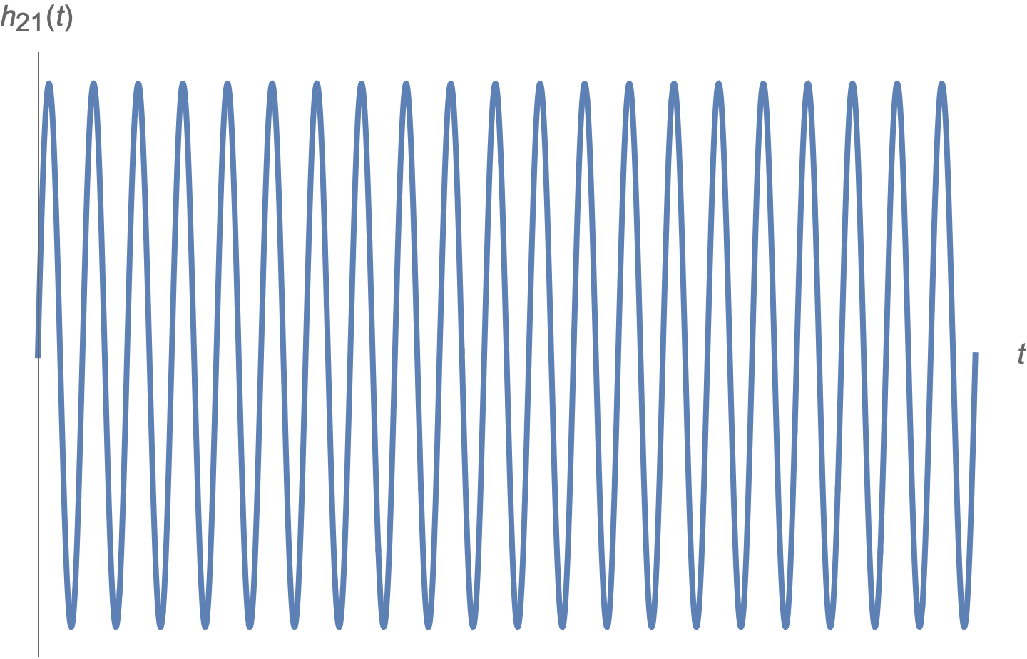
What if you miss a cycle?
Top: signal that goes through 21 cycles at some amplitude
Bottom: signal that goes through 20 cycles at some amplitude
Their ”match” is exactly zero!
True for any N cycles, miss one cycle and you lose the match
One of the main criteria for waveform model quality: phase accuracy, or, don’t miss a cycle
See e.g. Flanagan & Hughes gr-qc/9701039

Slide 7
The Lindblom criterion
A slightly better test of accuracy for broadband signals is the Lindblom criterion (Lindblom+ 0809.3844)
Consider a waveform $h(f)$ with a real amplitude $A(f)$ and a phase $Φ\left(f\right), h=Ae^{iΦ}$
For a given SNR an error in the amplitude $A→A+δA$ and phase $Φ→Φ+δΦ$ will not be possible to detect if
$${\overline{(δA/A})}^{2}+{\overline{δΦ}}^{2}<\frac{1}{SNR^{2}} , \overline{k}≡⟨kh|kh⟩$$
Strong criterion, detector-dependent, event-dependent

Slide 8
Birds-eye view of binary waveform modelling
Image credit: GW190412 imaged by GWPV by Nils Vu, nilsvu.de/gwpv/

Slide 9
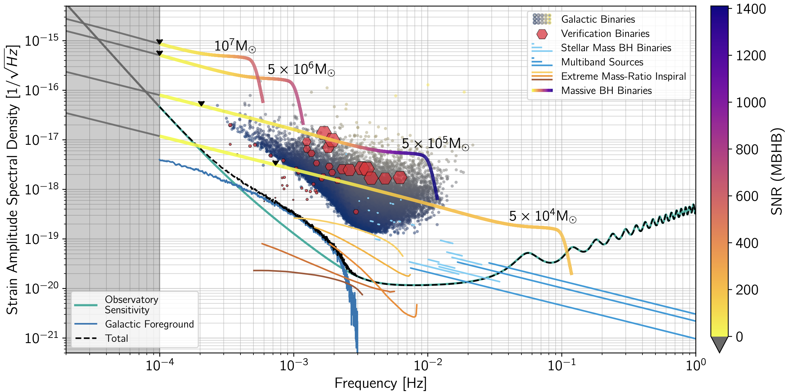
LISA sources (From Red book, 2402.07571)
LISA massive black hole binaries SNRs up to ${∼10}^{4}$, $→\overline{δA/A}, \overline{δΦ}$ $<{10}^{−4}$
Loudest EMRIs SNRs possibly up to ${∼10}^{3}$, $→\overline{δA/A}, \overline{δΦ}$ $<{10}^{−3}$

Slide 10
Different mass ratios and separations require different methods
Credit: LISA Waveform working group White paper, 2311.01300

Slide 11
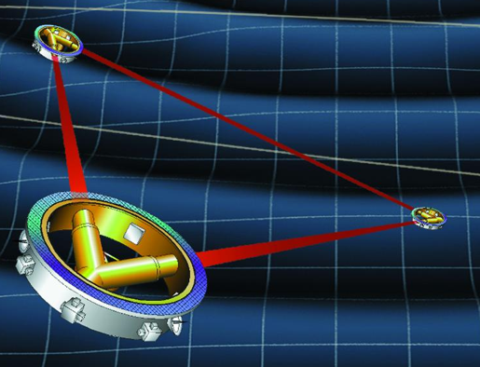
Mass ratio in GWs from binaries
$L∼\frac{M_{1}^{2}M_{2}^{2}\left(M_{1}+M_{2}\right)}{r^{5}}$,
$η^{}=\frac{M_{1}M_{2}}{M^{2}},M=M_{1}+M_{2}$
Peak luminosity only(!) $∼η^{2}$
Peak strain $∼ηM/D_{L}$
Time spent around peak $∼M/η$ ($∼1/η$ cycles)
$¼$
(at fixed total $M$)
$$M_{1}$$
$$M_{2}$$
SHORT
& LOUD
$$η$$
$$M_{1}$$
LONG
& QUIET
$$M_{2}$$
$0^{+}$
Notes:
11

Slide 12
Phasing in the mass-ratio expansion
Start spiralling at a finite radius, what kind of contributions appear in the final/plunge phase? ($η∼$ the ratio of the small mass w.r.t. the big mass)
Dissipative, resonant, conservative, spin corrections (upper index indicates the power of $η$ with which the terms appear in equations of motion)
Most of these pieces are work in progress! Prague work
$$φ_{fin}=φ_{diss}^{(1)}+φ_{reso}^{(1)}+φ_{cons}^{(1)}+φ_{spin}^{(1)}+φ_{diss}^{(2)}+φ_{reso}^{(2)}+O(η)$$
$$O(1/η)$$
$$O(1/\sqrt{η})$$
$$O(1)$$
$$O(1)$$
$$O(1)$$
$$O(\sqrt{η}?)$$
(also ~2PN)
Referring to the two-timescale decomposition of Hinderer & Flanagan 0805.3337

Slide 13
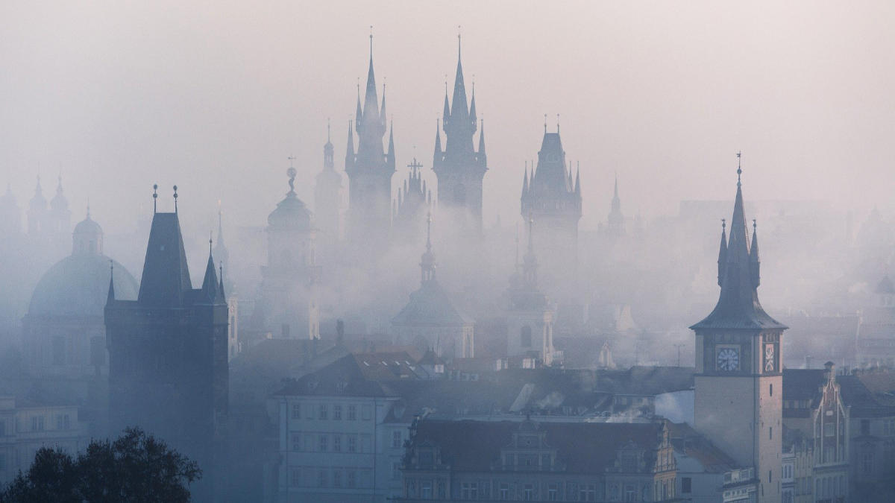
People at ITP and AsÚ working on dynamics, perturbations, and waveforms

Slide 14
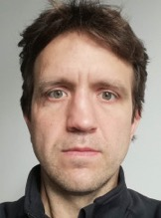
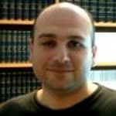
Senior postdocs and established researchers
Ondřej Kopáček (PhD 2011, sup. V. Karas at AsU, Chaos in BH magnetospheres)
Petra Suková (PhD 2013, sup. O. Semerák at ITP, Chaos in deformed BH fields with massive rings and disks)
Georgios Lukes-Gerakopoulos (PhD 2010 sup. G. Contopoulos in Athens, Relativistic chaos, arrived to ITP 2014, now leading team at AsU)
VW (Masters under O. Semerák at ITP 2015, Research project on BH chaos, PhD Bremen, …, now leading team at ITP)

Slide 15
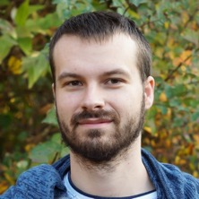
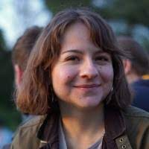
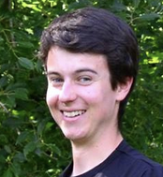
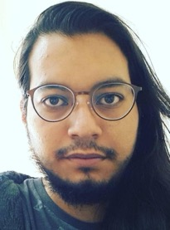
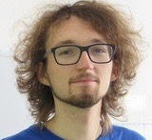
Junior postdocs and PhD students
Lukáš Polcar (PhD 2023, sup. O Svítek at ITP, BH deformations and canonical orbital perturbation theory, now at ITP)
O. Zelenka (PhD 2023, sup. B. Brügman, Jena, Applications of machine learning to GWs, numerical simulations, now at AsU)
V. Skoupý (PhD 2023, sup. G. Lukes-Gerakopoulos at AsU, Fluxes of spinning secondaries in EMRIs, now at ITP)
Angelica Albertini (started PhD 2022, sup. G. Lukes-Gerakopoulosa, AsU, EOB, large mass ratio limit)
Alvaro Rafael Martinez Gomez (started PhD 2023, sup. VW at ITP, GWs and gravity dynamics through dualities with Yang-Mills)
Master students, loosely associated PhD students (Petr Kotlařík, Claudia Caputo,…)

Slide 16
Research highlights and broader collaborations

Slide 17
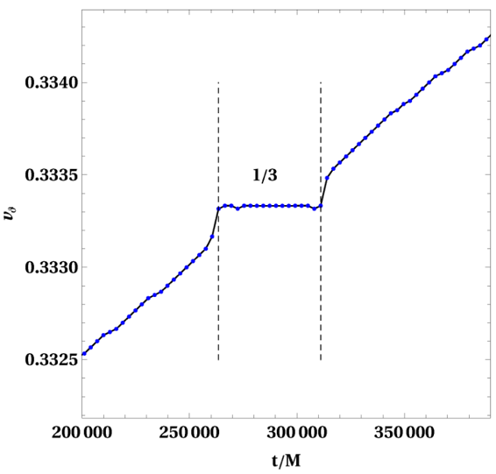
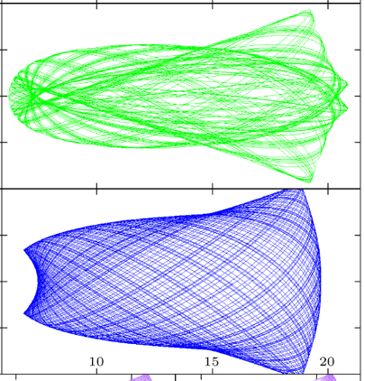
Research highlight 1: Resonances and chaos in inspirals
During inspirals, this manifests as “locked” frequency ratios, or plateaus
Perturbations generate new types of orbit in system, resonant, and chaotic, in the neighborhood of slightly deformed regular ones
If neglected, this leads to $\sqrt{ε }/η$ errors in EMRIs ($ε$ perturbation parameter)
Image: VW, Semerák, Suková 1503.09077,
Image: Lukes-Gerakopoulos & VW, 2103.06724

Slide 18
Method sketched in Lukes-Gerakopoulos & VW, 2103.06724 refined and implemented to treat self-force resonances during inspirals
WIP with Philip Lynch (AEI Potsdam-Golm), Niels Warburton (UCD), Maarten van de Meent (AEI/Niels Bohr Inst.)

Slide 19
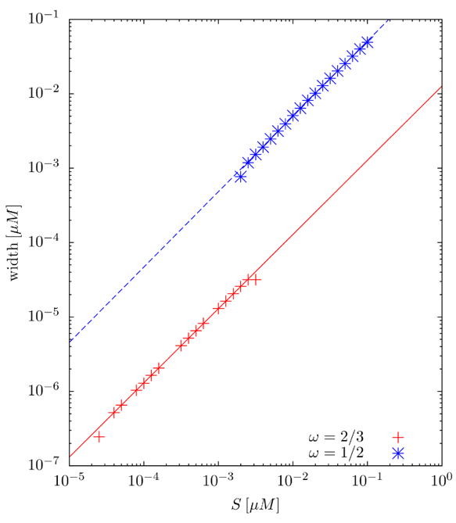
Research highlight 2: Spinning secondary
Spin – a new degree of freedom, enters into equations of motion at linear order in mass ratio
Ambiguities in center of mass choice – which choice is practical? (Kyrian & Semerák 1999, Lukes-Gerakopoulos+ 2014,…)
Does spin perturbation cause chaos? Not at linear order, yes at quadratic (VW 1903.03651, Zelenka+ 1903.03651, VW & Piovano 2308.00021)
Solving EOM and coupling to Teukolsky equation yields corrections to fluxes needed for post-adiabatic correction to phases (Skoupý, Lukes-Gerakopoulos + 2102.04819, 2201.07044, 2303.16798)
Incorporation into Effective One Body models (Albertini+ 2310.13578)

Slide 20
Codes and broader collaborations
Teukode time-domain solver for the Teukolsky equation development (Harms+1406.5983)
Teukolsky frequency-domain solver (Skoupý, Lukes-Gerakopoulos + 2102.04819, 2201.07044, 2303.16798)
Contributions to the BHPToolkit, bhptoolkit.org, Mathematica and other packages for BH perturbations theory (KerrGeodesics, SpinningSecondary packages)
Active members of LISA Waveform Working Group (e.g. recent whitepaper 2311.01300)
Ties with TEOBResumS waveform group (A. Nagar, S. Bernuzzi)

Slide 21
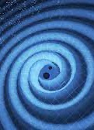
Summary
No huge ”traditional” group with dedicated senior professors, but the Two Towers (teams at AsU and ITP)
Dynamical system analysis (numerical, analytical)
Resonances and their impact
Secondary spin
Large mass ratio inspirals
Code development, contributions to LISA WavWG, TEOB and others

