Slide 1


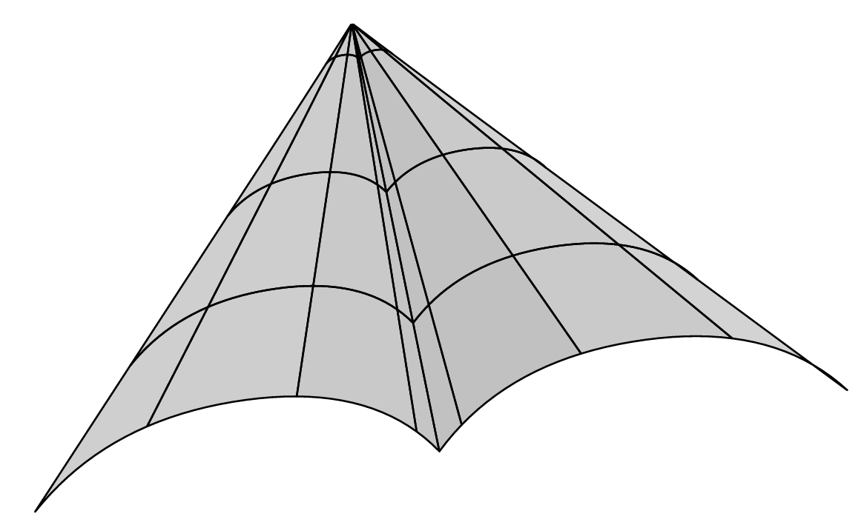

Theory in time-domain astrophysics
Ondřej Pejcha
ÚTF MFF UK
https://utf.mff.cuni.cz/~pejcha

Slide 2
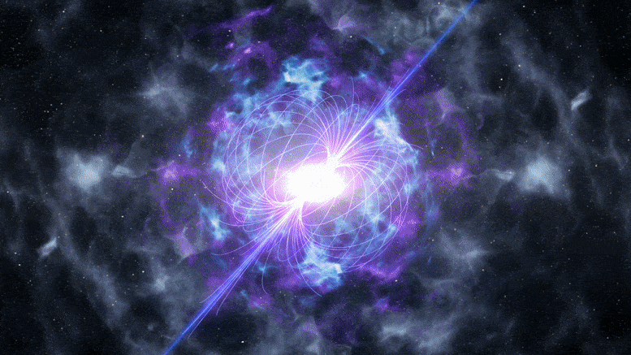
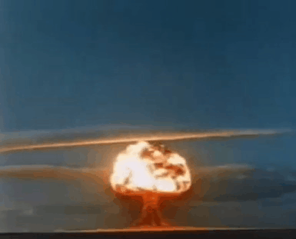
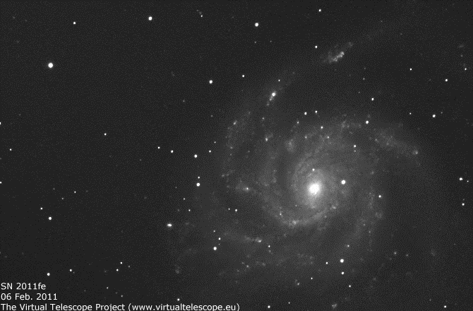
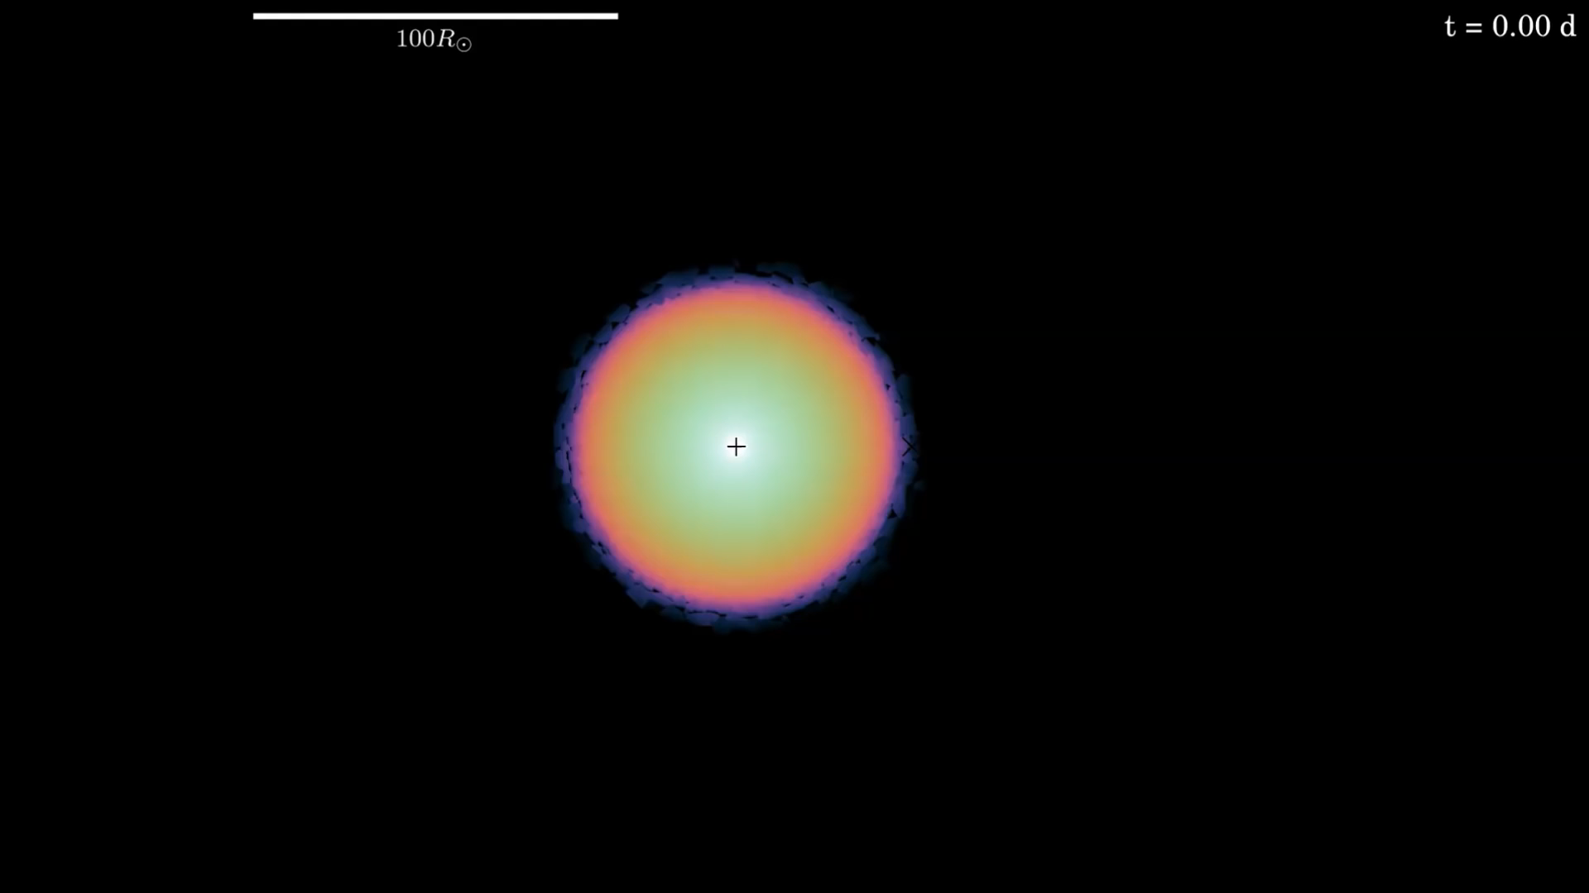
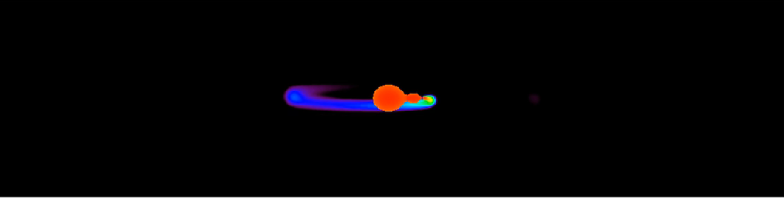
What is time-domain astrophysics?

Slide 3
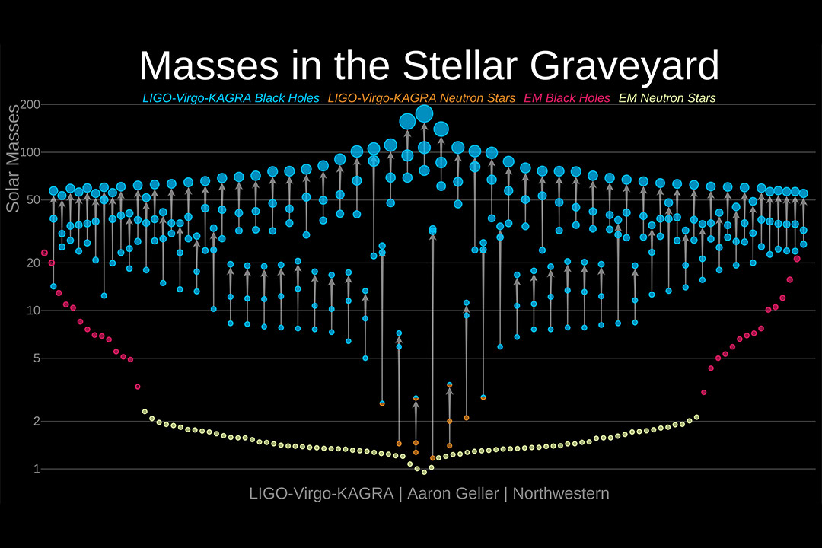
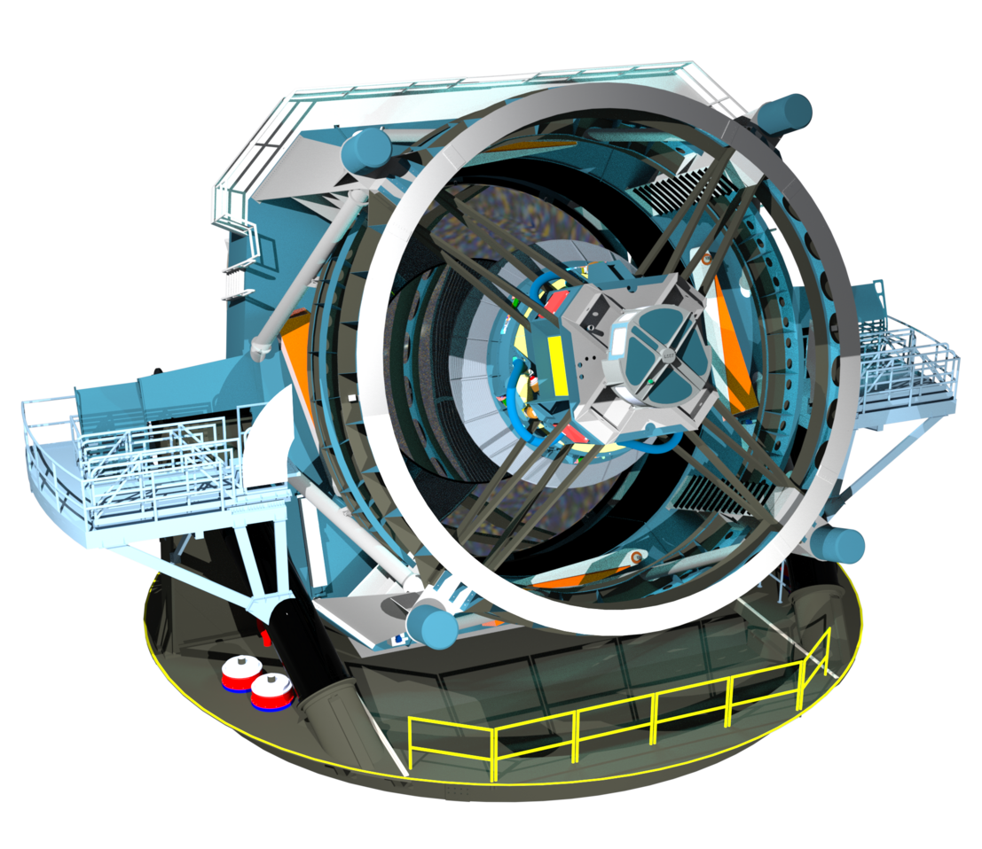
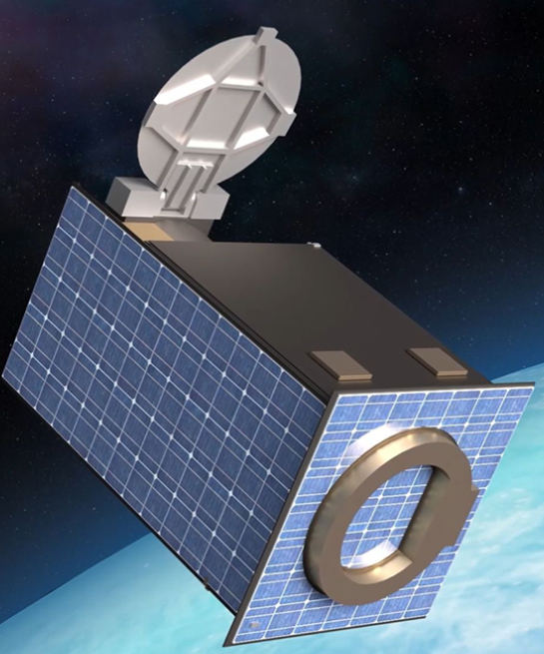
Why time-domain astrophysics now?
Legacy Survey of Space and Time:
>1 million supernovae/year
LIGO & Virgo
QUVIK: First Czech space telescope
(launch 2028)

Slide 4
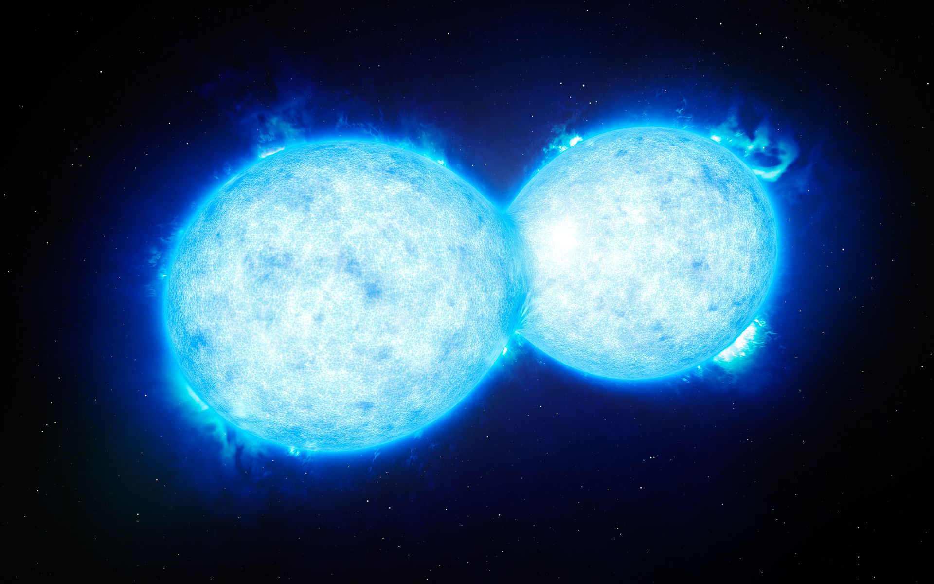
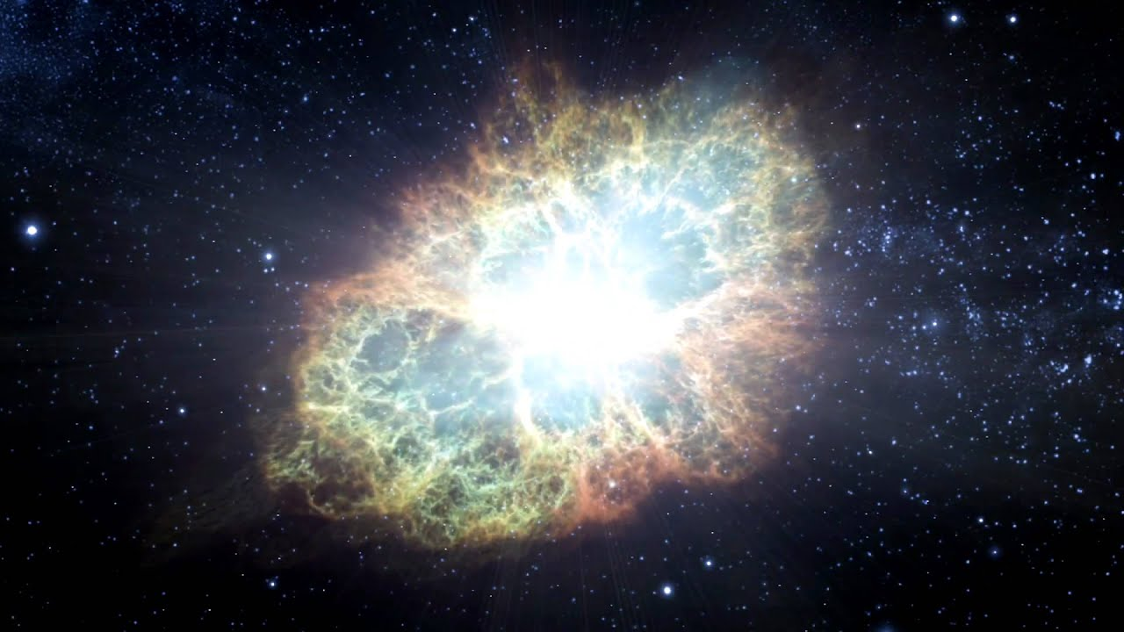
What do we study?
Theory directly relevant for observed objects
Binary stars
Explosions

Slide 5
What are the big questions?
What is the origin and evolution of gravitational wave sources?
How do various processes inside stars really look like?
What happens during death of (massive) (binary) stars?
What are the sites of acceleration of highest energy particles?

Slide 6
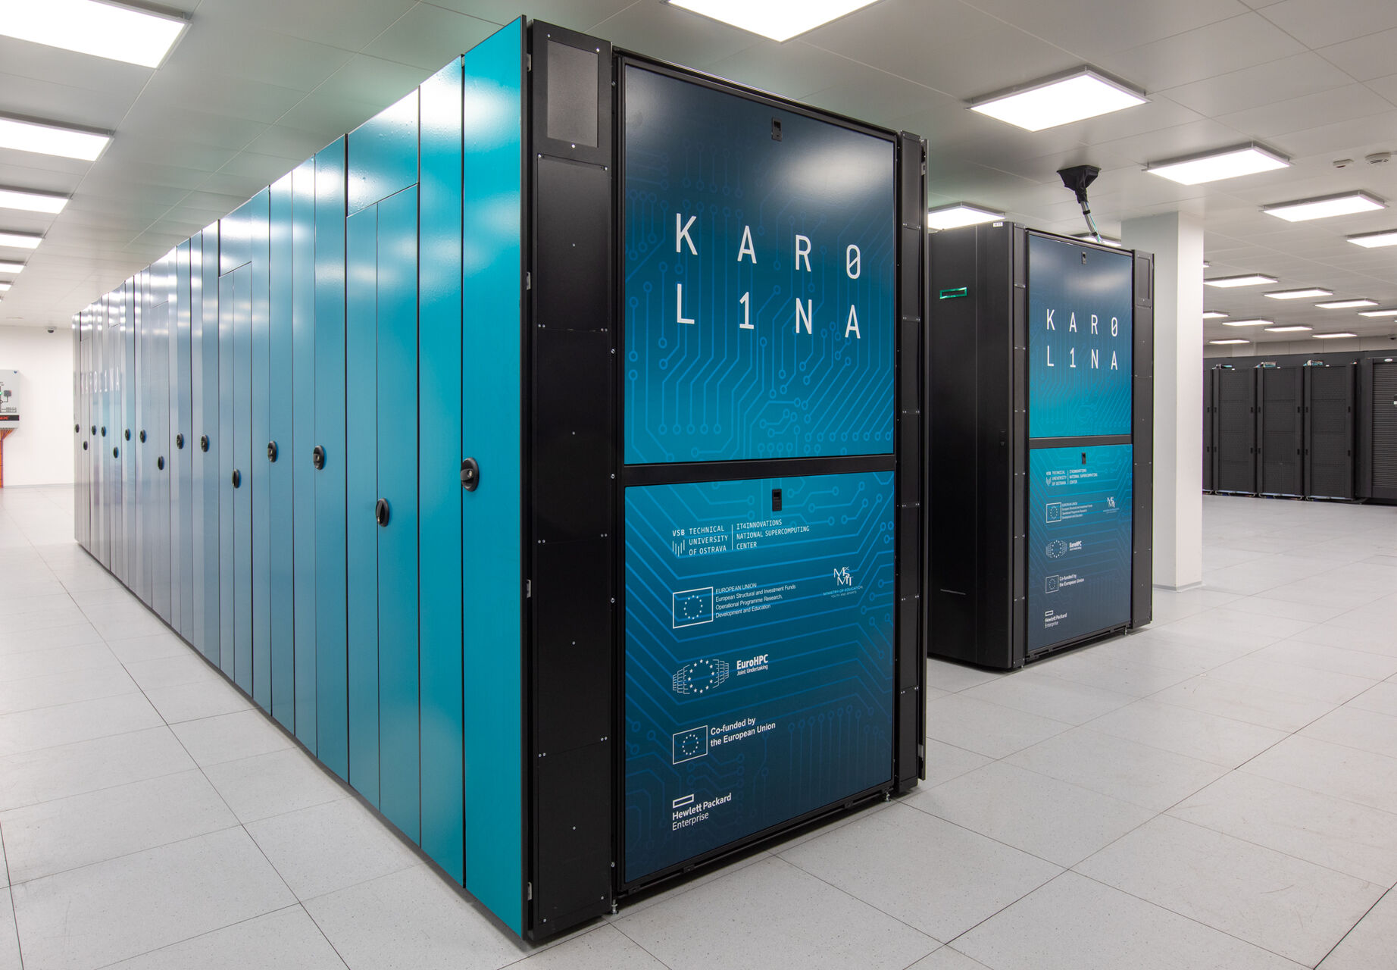
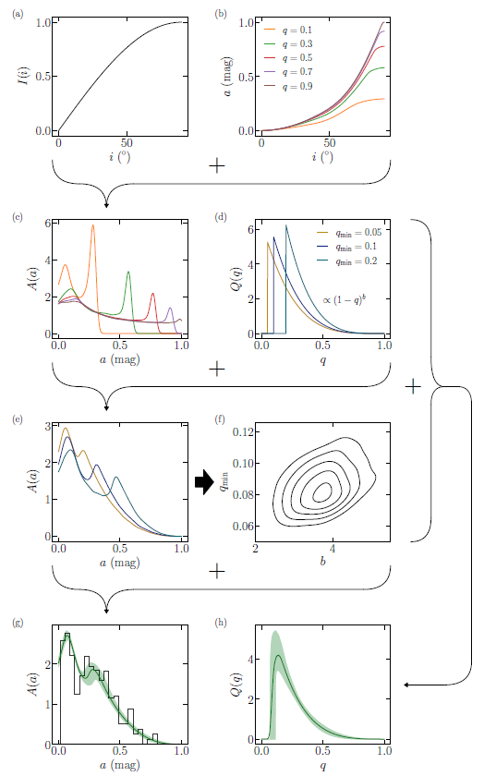
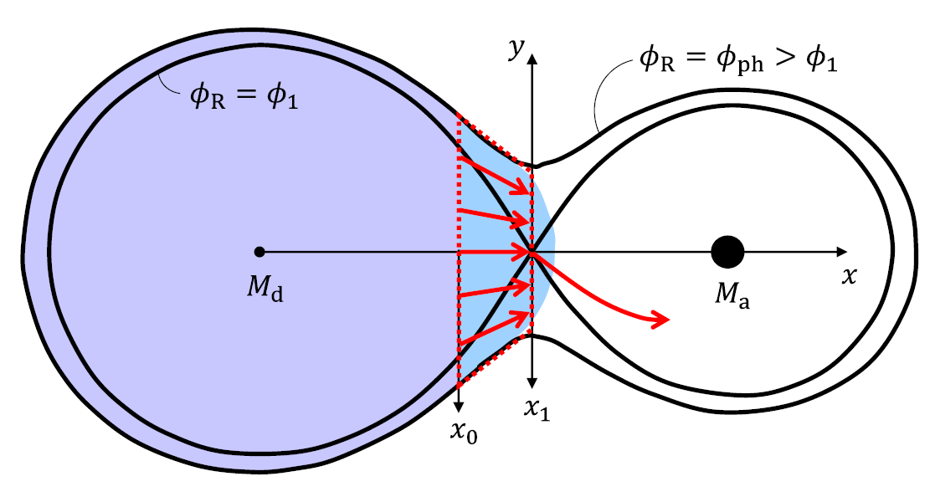
What tools do we use?
Mathematical modeling
(Semi)analytic modeling
Machine learning
Numerical solution of partial differential equations
Personal computers and small clusters, GPUs
National high-performance computing
~10 million CPU-hours/year
Analytic and numerical solution of ordinary differential equations
Hydrodynamics
Radiation, magnetic fields
Physical realism – from dust to neutrinos
Bayesian hierarchical models
Classification
Data from ground- and space-based facilities

Slide 7
Theory in time-domain astrophysics
Ondřej Pejcha
ÚTF MFF UK
Your interests + preferred tools + astrophysical relevance → unique project
See for examples of past work (papers with students)
https://utf.mff.cuni.cz/~pejcha

