Slide 1
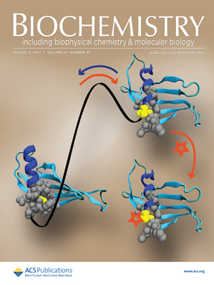
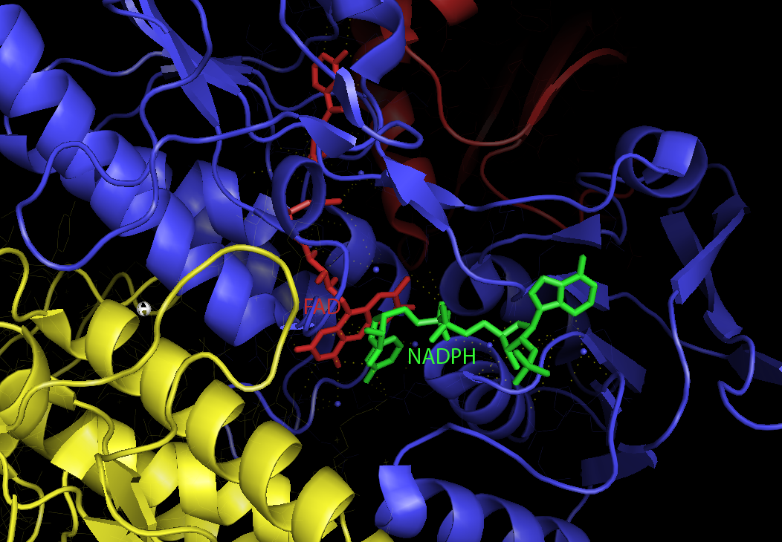
Kvantově-mechanický a QM/MM popis reakčních center:
Termodynamický a kinetický pohled na inhibici rakovinných mechanismů.
Jaroslav Burda, KCHFO
Výpočty energetických profilů interakcí kovů s biologicky aktivními místy v buněčném prostředí: QM a QM/MM popis termodynamiky a kinetických faktorů a jejich ovlivnění pH prostředím.
Interakce Au(I) komplexů s thioredoxin reduktázou => zvýšení oxidačního stresu v rakovinných buňkách => apoptóza
pH závislé modely pro výpočet Gibbs-Albertyho volné energie: kde se při jakém pH koordinují zvolené komplexy?
Pt:O Pt:S Pt:N preference

Slide 2
QM/MM study on Ru(II) cross-linked GG structure in decamer ds-DNA model
10 base-pair DNA oligonucleotide with sequence 5'-ATGGGACCT-3’ (standard B-DNA structure parameters, Watson-Crick base pairing)
Relaxation of DNA structure by MD run in water (Amber FF03, T = 300 K, p = 1 atm, total charge set to zero by adding Na+ cations) and consequent MM minimization
Initial structure of Ru(II) complex from previous QM/MM calculations, MM parametrization of organic ligands by GAFF, atomic point-charges were determined by RESP method

Slide 3
How to address pH dependent ΔG?
An example:
water as H₃O⁺, H₂O, and OH⁻
two forms of the Pt-complex - cis-[Pt(NH₃)₂Cl(H₂O)]⁺ and cis-[Pt(NH₃)₂Cl(OH)]
four different states of cysteine: protonated Cys⁺, neutral Cys,
and two deprotonated forms: Cys⁻ and Cys²⁻
Pt(S-Cys) complex in 1- , neutral, and 1+ charged forms:
cis-[Pt(NH₃)₂Cl(H₂O)]⁺ + Cys → cis-[Pt(NH₃)₂Cl(S-Cys)]⁺ + H₂O
➡

Slide 4
How to address pH dependent ΔG?
An example:
comprises:
two forms of the Pt-complex - cis-[Pt(NH₃)₂Cl(H₂O)]⁺ and cis-[Pt(NH₃)₂Cl(OH)]
four different states of cysteine: protonated Cys⁺, neutral Cys,
and two deprotonated forms: Cys⁻ and Cys²⁻
water as H₃O⁺, H₂O, and OH⁻
Pt(S-Cys) complex in 1- , neutral, and 1+ charged forms:
cis-[Pt(NH₃)₂Cl(H₂O)]⁺ + Cys → cis-[Pt(NH₃)₂Cl(S-Cys)]⁺ + H₂O
➡

Slide 5
pH dependent rate constant ?
$${[XH}^{tot}]={[X}^{−}]+[XH]$$
$$K_{a}=\frac{{[X}^{−}][{[H}^{+}]}{[XH]}. → \left[XH\right]=\frac{{[X}^{−}][{[H}^{+}] }{K_{a}}.$$
$${[XH}^{tot}]={[X}^{−}]+ \frac{{[X}^{−}]\left[{[H}^{+}\right]}{K_{a}}=(\frac{K_{a}+\left[H^{+}\right]}{K_{a}}){[X}^{−}]$$
$${[X}^{−}]=(\frac{K_{a}}{K_{a}+\left[H^{+}\right]}){[XH}^{tot}]; [XH]=(\frac{\left[H^{+}\right]}{K_{a}+\left[H^{+}\right]}){[XH}^{tot}]$$
$$\frac{d\left[S\right]}{dt}=−k_{1}\left[S\right]\left[XH\right]−k_{2}\left[S\right] \left[X^{−}\right]=$$
$$={−\frac{{k_{1}\left[H^{+}\right]}^{}+k_{2}K_{a}}{{\left[H^{+}\right]}^{}+K_{a1}}\left[S\right]\left[{XH}^{tot}\right]}=−k^{eff}\left(pH\right).\left[S\right].\left[{XH}^{tot}\right]$$

Slide 6
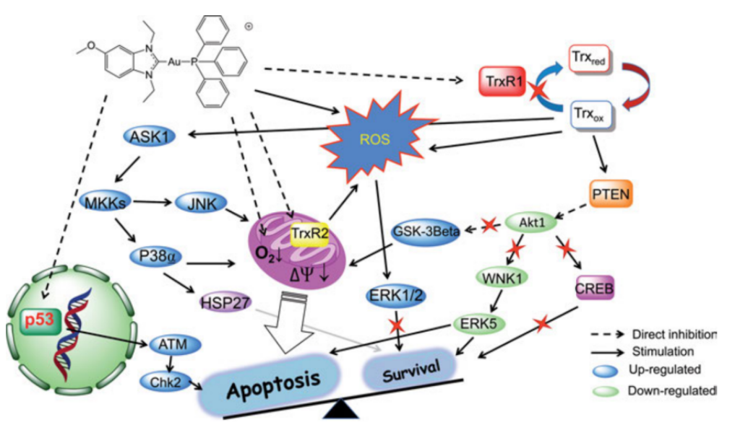
Au(I)NHC linkaged structure block correct functioning of TrxR enzyme

Slide 7
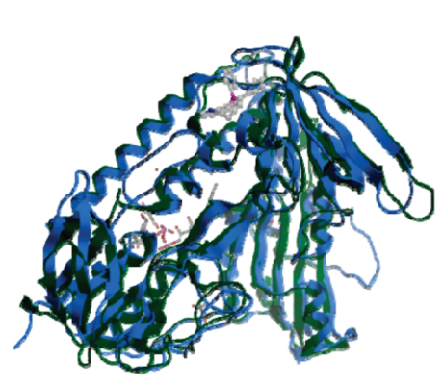
X-ray structure of monomer of TrxR
Q.CHENG,T.SANDALOVA,Y.LINDQVIST,E.S.ARNER
CRYSTAL STRUCTURE AND CATALYSIS OF THE SELENOPROTEIN THIOREDOXIN REDUCTASE
J.BIOL.CHEM., 284, 3998 (2009)

Slide 8
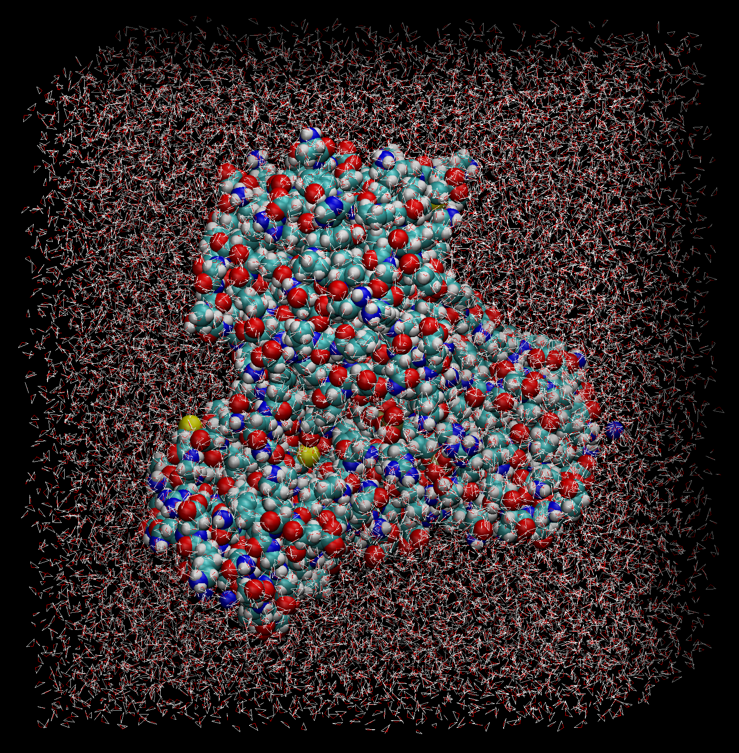
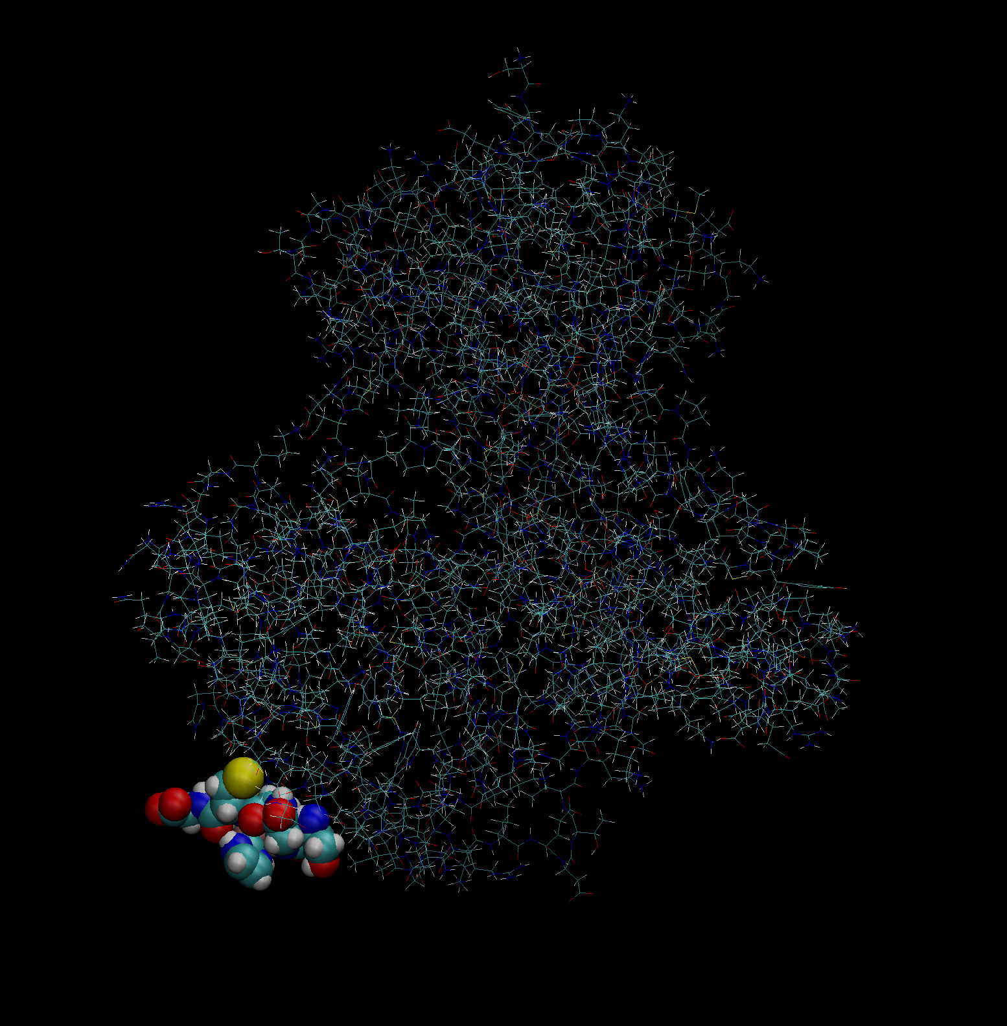
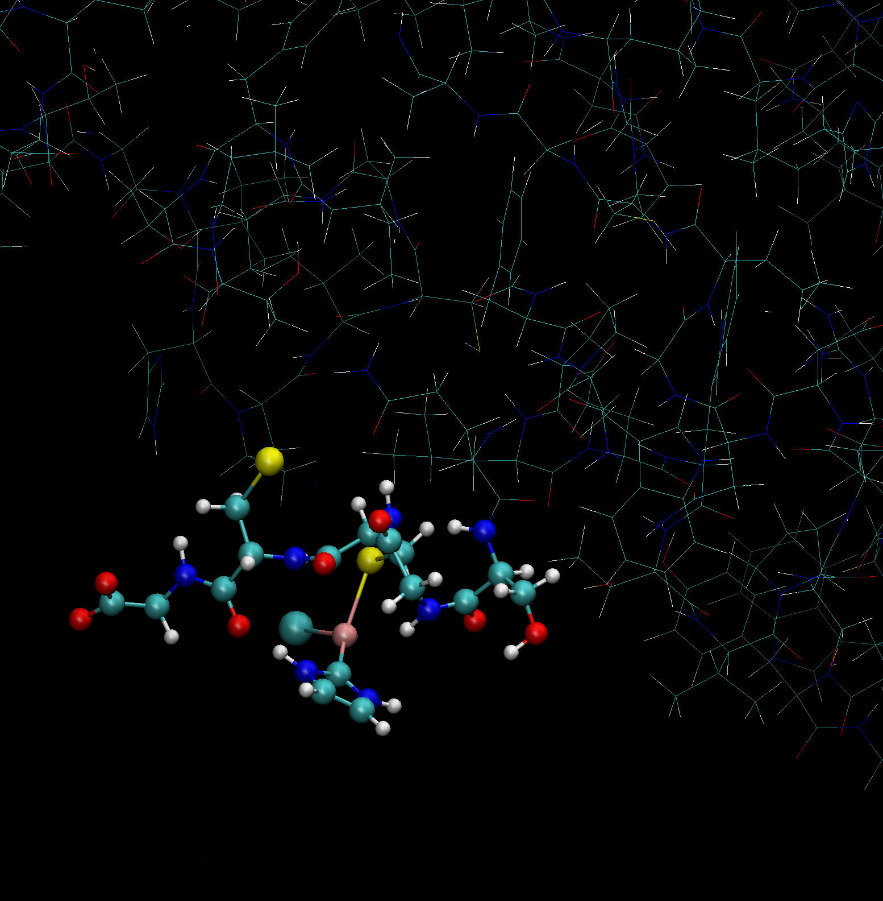
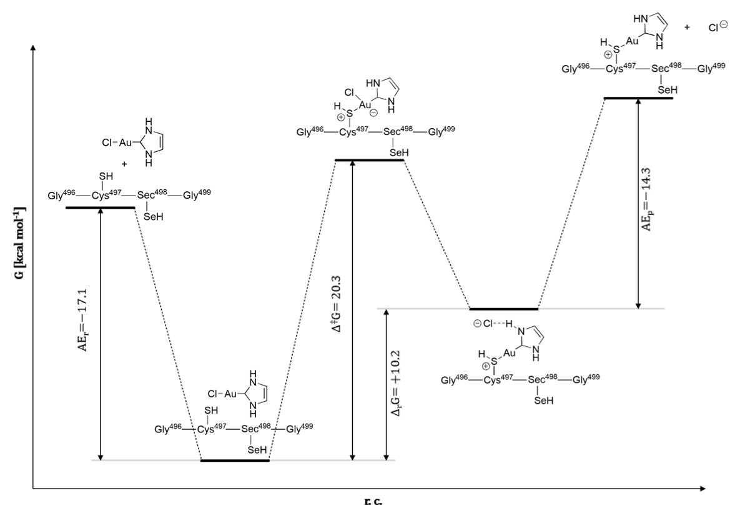
presently studied problem: QM/MM study on Au(I) linkage structure in TrxR enzyme
Oxidized (upper) and reduced forms (lower) of the active site in thioredoxin reductase (Trx-R)
37

