Slide 1
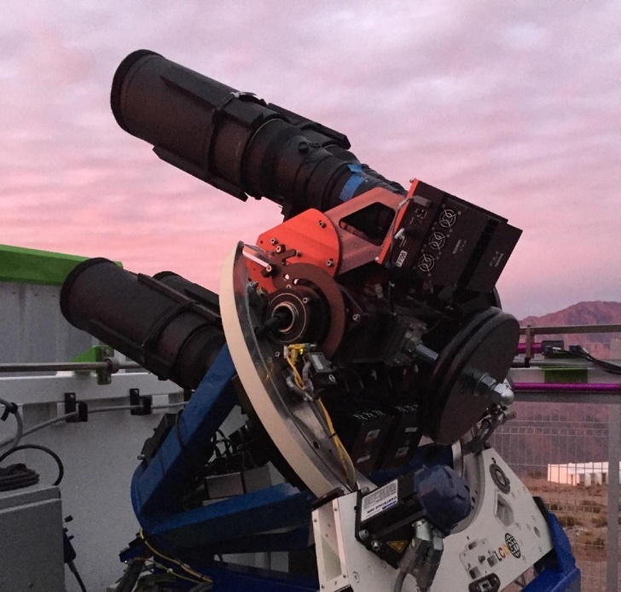
Simulations of astrophysical explosions:
Influence of binary stars and other stellar exotica
Ondřej Pejcha
http://utf.mff.cuni.cz/~pejcha/
Radiation hydrodynamics on moving meshes
Applications:
Supernovae
Classical novae
Colliding winds
Other weird transients
Optical, X-ray, gamma-ray

